Slide 1




ZOMATO RESTAURANT ANALYSIS
SHRISHTI SHRIVASTAVA
20/04/2025

Slide 2
INTRODUCTION
Did you know originally Zomato was called Foodiebay, founded in 2008 .Initially, it was not a delivery app — it was a restaurant discovery and review platform.
But look at now it is one of the most successful delivery app in India.
Despite being an Indian company it’s constantly trying to expand its business all over the world .
Currently :
Countries Operating In: 24 countries
Registered Users: Over 70 million
Languages Supported: 10 languages
Number of Restaurant Listings: 1.5 million
Around 90 million visits monthly.
So, the main concern is expanding business in various countries by analyzing the given dataset .
We should select that place which will provide maximum profit.

Slide 3
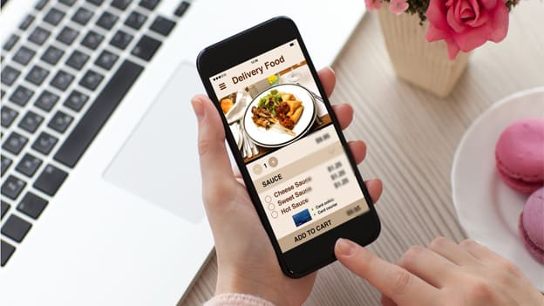
PROJECT AIM
The objective of the project is to analyze the data of Zomato restaurants across the country and retrieve some meaningful insights for the growth of the business.

Slide 4
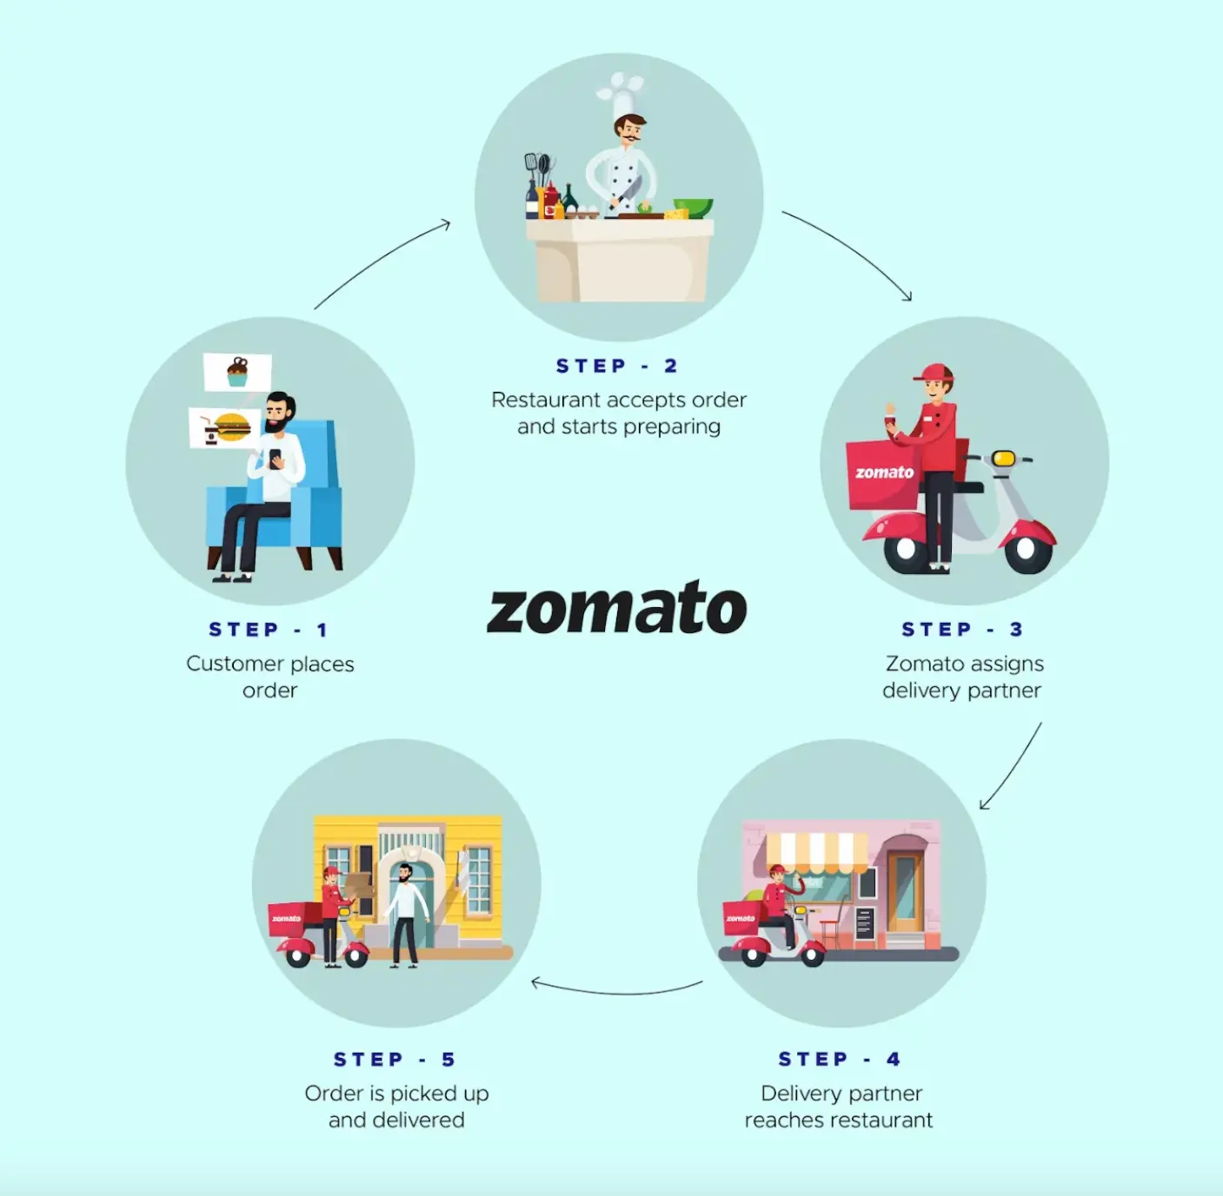
ZOMATO WORKFLOW
Search for Restaurants
View Restaurant Details
Place an Order
Acceptance & preparation of order
Payment
Delivery
Review

Slide 5
Data Overview
The dataset provided contains 9551 restaurants covering 15 countries and 141 cities. Zomato has major market in India with 8562 restaurants.
Most number of the restaurants were opened in year 2018.
Restaurants have price range between 1- 4.
Different restaurants have different ratings based on their cities cuisines and price range.
Data Cleaning
Utilized functions like TRIM,UPPER(proper capitalization) for proper formatting.
There are null values present in columns Longitude, Latitude and which are replaced by their average values.
There are 9 blank cells found in the column cuisines that are replaced by cuisines based on their country codes.
All currencies are updated in the Indian Rupees in the new column created named as Average_cost (INR).
Year is extract from the column Datekey_Opening.
Data is well maintained with help of wrap text, borders and Bold functions.
Replaced ÛÁstanbul (doesn’t exist) to Istanbul .

Slide 6
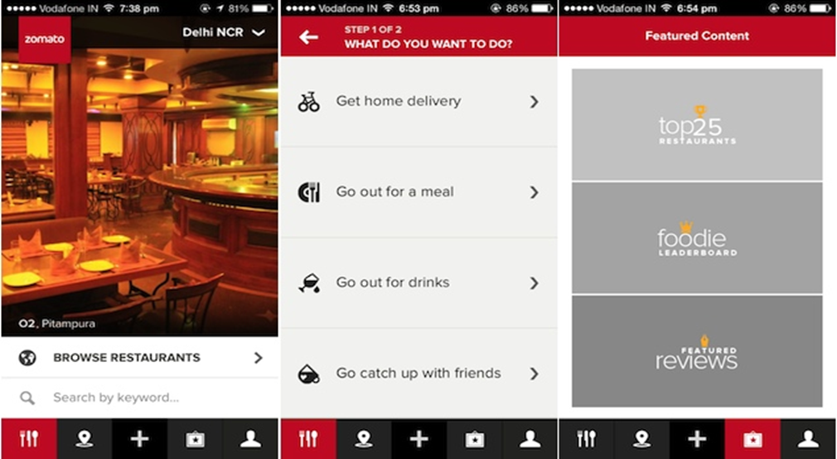
METHODOLOGY
Handling missing values – Using average function missing values are handled.
Data Enrichment – Mapped Country Codes to country names using VLOOKUP. Applied conditional formatting on Rating and price range. Enhance the data with help of left functions.
Pictorial Visualization – Using of Pivot Tables, Different charts helps to overcome the data very easily and handy.
Segregation of Data – Data is separated by using filters, slicers year wise & country wise.
Data Visualization – Created interactive dashboard of the whole data, so that we can check most of thing on single click.

Slide 7
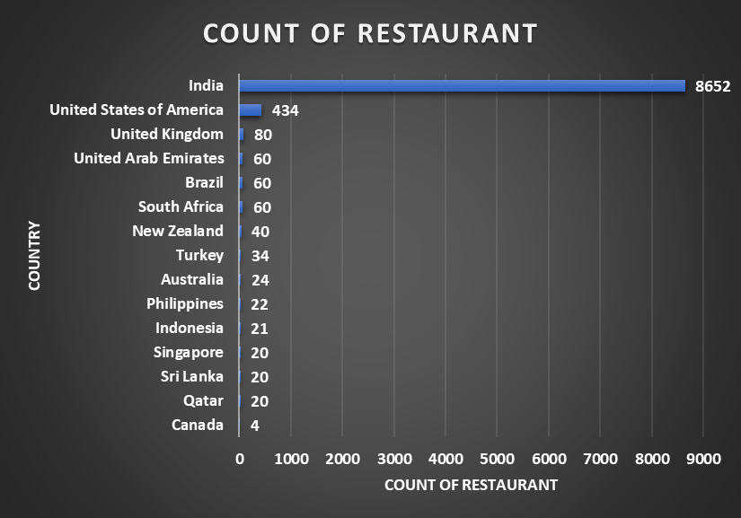
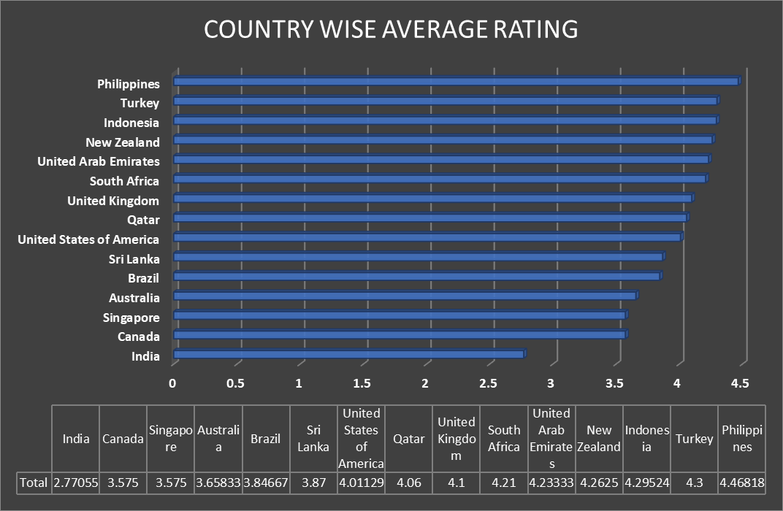
Country-Wise Restaurant Distribution & Ratings
From the bar chart we can see,
India has 8562 restaurants accounting 90.59% .
Whereas, Canada have only 4 restaurants comprising 0.04%.
Philippines defeating all countries in terms of ratings.
Whereas India is at the bottom of the list on scale of average ratings.

Slide 8
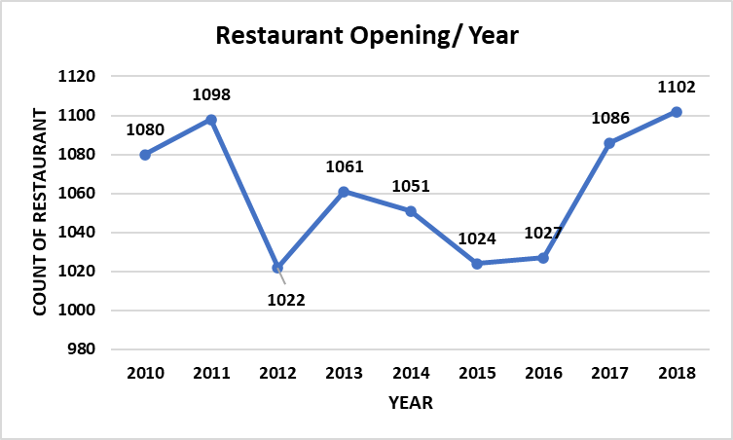
Identifying Growth Trends
We can see around 1000 restaurants are opened each year.
2018 is leading the chart with 1102 restaurants.
In 2012 only 1022 restaurants were opened attaining the least spot in the chart.

Slide 9
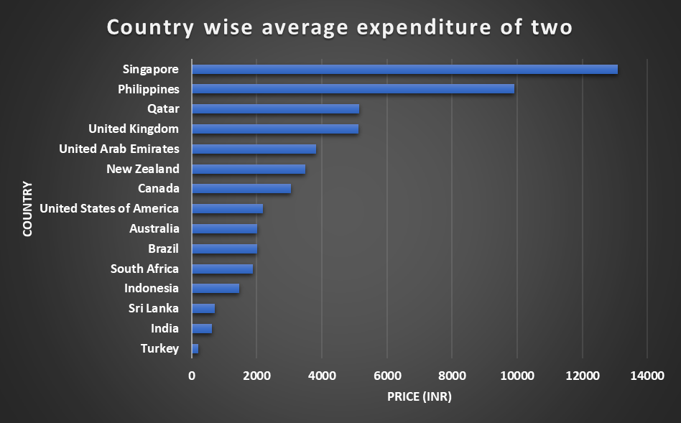
Understanding Market Affordability
Here we can say countries like India, Indonesia and Turkey are having lowest expenditure cost.
Singapore has highest expenditure among all the countries listed.

Slide 10
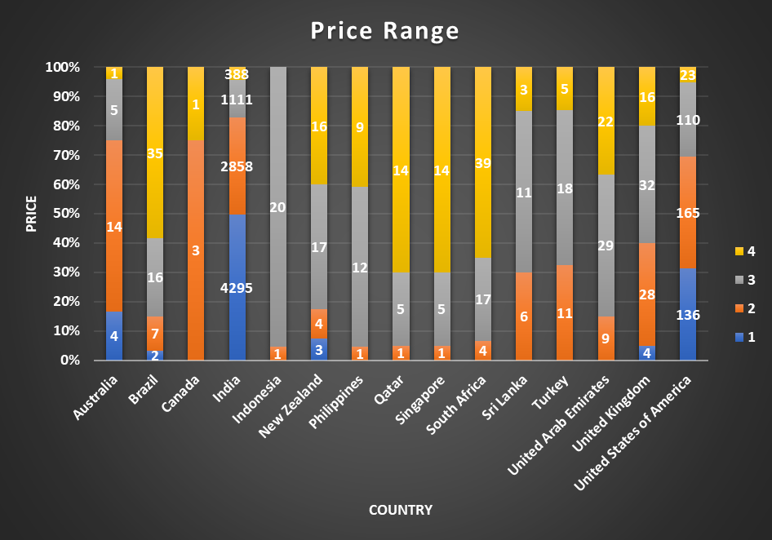
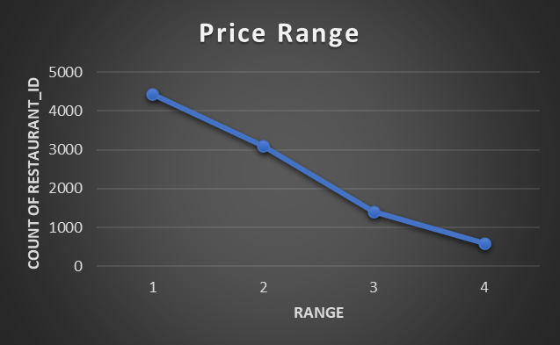
Understanding Market Spending Behaviour
Different countries have different number of restaurants within the different price range. Whereas India have the maximum number of the of the restaurants among all price ranges. States such as the United States, United Kingdom, and South Africa have a more balanced distribution across the different price ranges but with significantly lower totals compared to India. Countries like Indonesia, Sri Lanka, and Qatar, have minimum number of restaurants.
From the line chart we can notice as the price range increases the count od restaurant decreases.

Slide 11
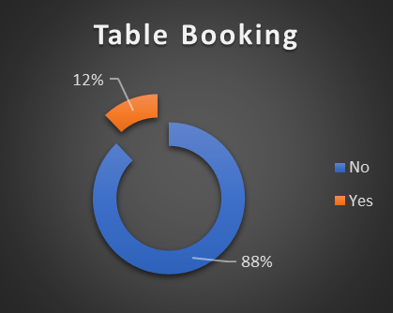
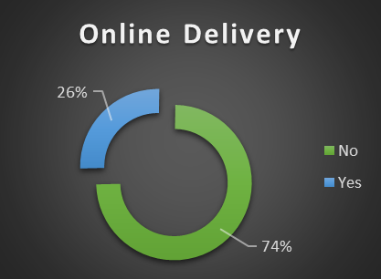
Table Booking and Online Delivery Details
74% Restaurants do not have online delivery.
Only 26% Restaurants have Online Delivery
88% Restaurants do not have table booking
Only 12% Restaurants have table booking.

Slide 12
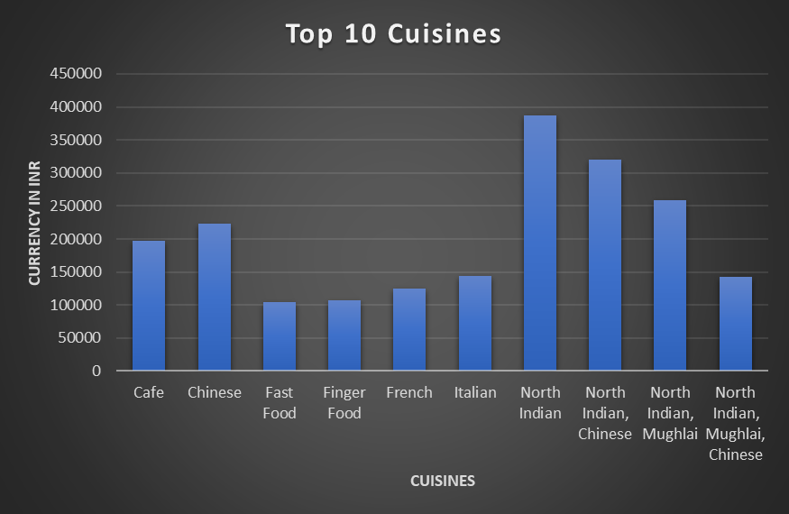
Understanding Customer Preferences
North Indian cuisines are on top of the table on the basis of average cost of two in Indian rupees.

Slide 13
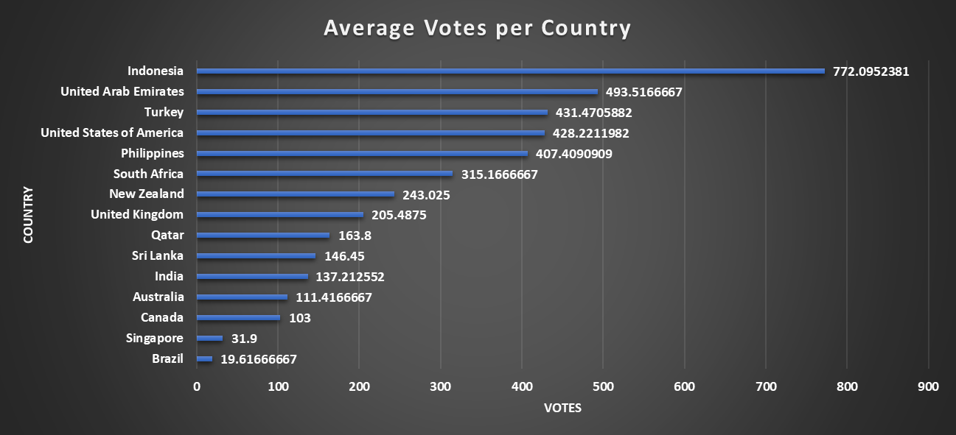
Average Votes per Country
Indonesia is the only country which crosses the average line of 500 votes and got highest number of average votes defeating all the countries worldwide.

Slide 14
COUNTRY Selection For Opening New Restaurant
CANADA : The restaurant count was least i.e only 4 restaurants which were in different cities as well as average rating was 3.575. (Consort)
SINGAPORE : There were only 20 restaurants and the average rating was 3.575.
AUSTRALIA : The restaurant count was 24 with average rating of 3.65833.
(Montville ,Mayfield ,Balingup )
I have chosen these countries based on the count of restaurant coz these countries will have less competition
And another factor was average rating, I have chosen those countries having less rating due to following reasons:
-> As we can easily stand out if we offer a quality product
-> There might be possibility These countries have less competitive markets.

Slide 15
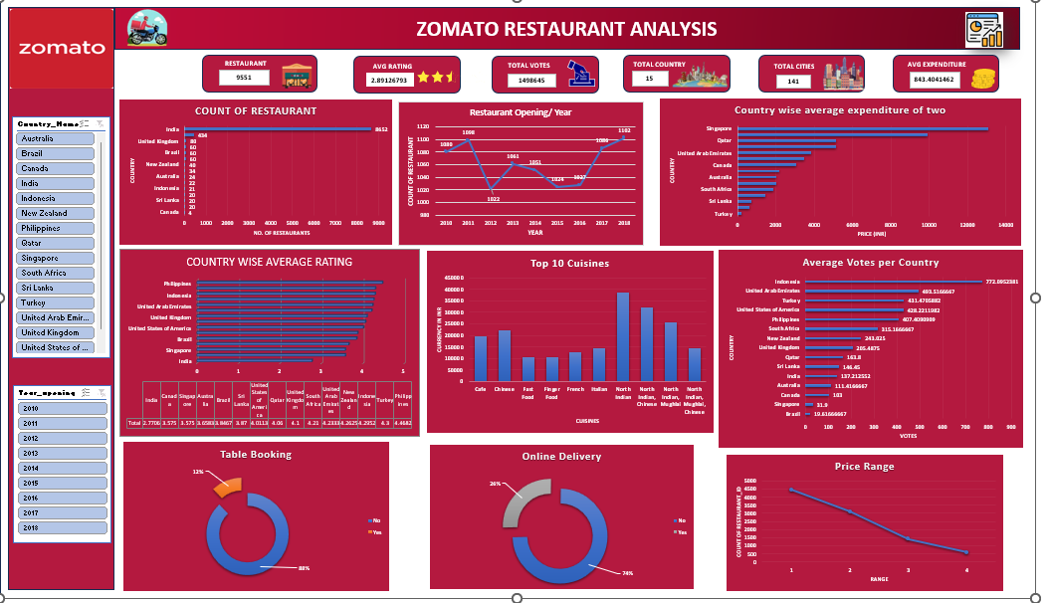
DASHBOARD

Slide 16
RECOMMENDATIONS
Zomato should capitalize on its multi-cuisine approach to cater to diverse tastes, enhancing its appeal to a broader customer base. They can add regional food items to gain better customer feedback
Canada, Singapore & Australia are some of the most unclustered markets for Zomato that may offer new opportunities for market penetration.
Customers are also ready to spend more money according to there need.
Online delivery and table booking generally exceed into a higher rating.
This approach to cuisine selection ensures that investments are tailored to the financial capacities and strategic goals of the stakeholders, maximizing the potential for success in the chosen markets.

Slide 17
CONCLUSION
In conclusion, our analysis of Zomato restaurant data reveals promising opportunities for strategic expansion across the globe. By targeting regions with high demand, catering to specific demographic preferences, and capitalizing on competitive advantages, we can confidently recommend the opening of new restaurants. This initiative not only enhances market presence but also delivers exceptional dining experiences, driving sustainable growth for Zomato and enriching the global culinary landscape.

Slide 18
THANK YOU

